Slide 1
Human-in-the-Loop AI Pattern Modeling for Medicare Fraud Detection

Slide 2
Why do we need to build our Fraud Detection system stronger?
WHY?
Notes:
Talking points-
In this demo today we ll answer to Why , What and How.
There are a lot of Fraud detecting systems today, but Fraudsters still commit Fraud
For today’s demo purposes Lets take DME as an example, as it combines a high payment-integrity risk rate with a strong history of large, sophisticated fraud schemes

Slide 3
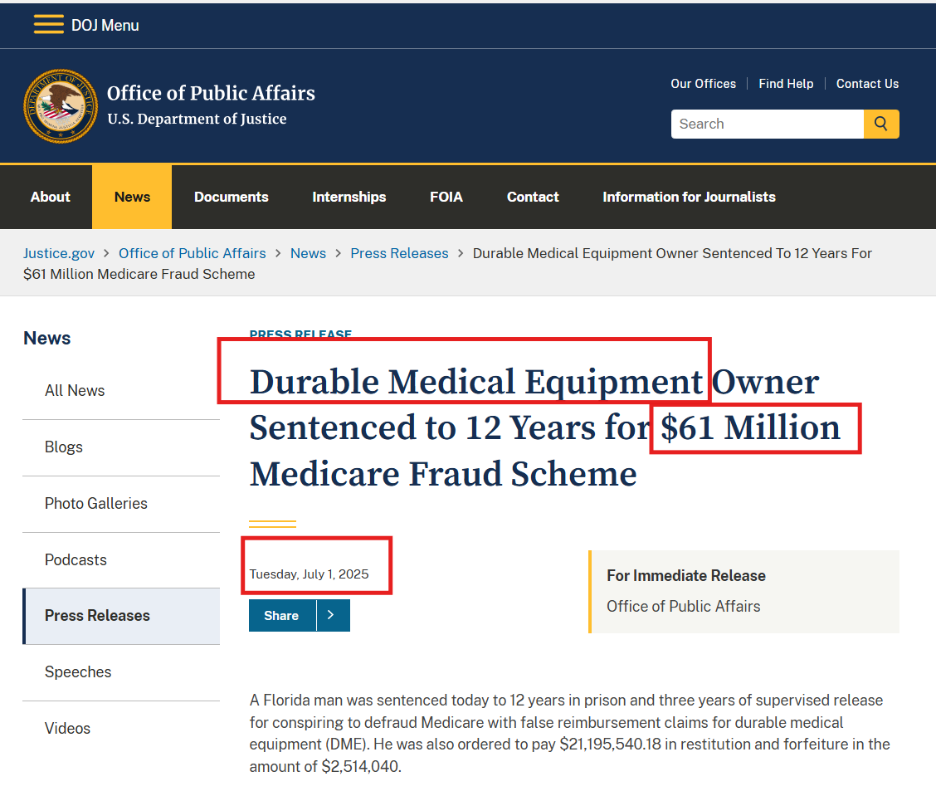
Case #1: $61M False-Billing DME Supplier
What happened here-
Hidden ownership
Paid patient referrals
Medically unnecessary DME billing
Takeaway-
At the simplest level, DME fraud can look like hidden ownership, fake referrals, and billing Medicare for equipment patients did not really need.

Slide 4
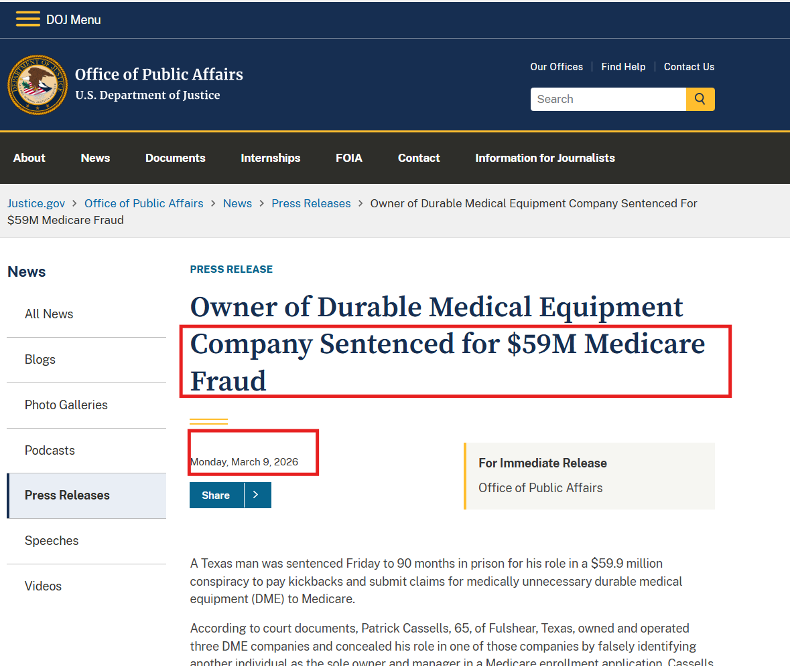
Case #2 : $59.9M Medically Unnecessary DME with Hidden Ownership and Kickbacks
What happened here-
Hidden ownership
Fake leads/kickbacks for doctor orders
Billing medically unnecessary braces
Takeaway-
A claim can look complete on paper, but still be fraudulent if the doctor’s order was generated through kickbacks or without real patient evaluation.

Slide 5
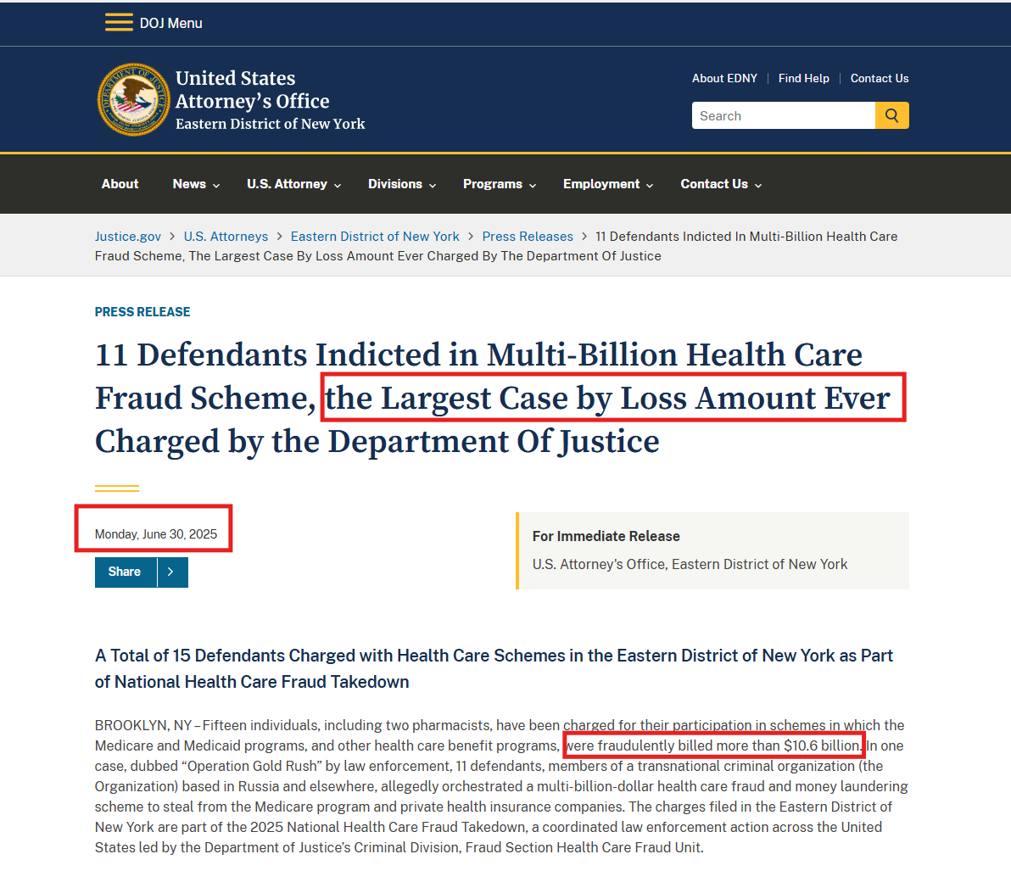
Case#3: Largest Fraud Ever!
$10.6B Rapidly Emerging Multi-Entity DME Billing Pattern
What happened here-
Hidden ownership
Multiple DME entities used together
Distributed fraudulent billing at scale
Takeaway-
The hardest fraud to catch is not always one bad actor. It can be a network of ordinary-looking companies that only becomes suspicious when you look at the pattern across all of them.

Slide 6
What can we do about it?
WHAT?

Slide 7
Problem Definition
Fraudsters are 10 steps ahead of our systems
Some major fraud schemes used by Fraudulent suppliers:
Hidden or obscured ownership
Fraud spread across multiple DME entities
Billing for medically unnecessary DME
Large-scale, distributed billing patterns
Questionable or invalid doctor orders
Notes:
We build system around NPI and thresholds patterns they hide behind … multiple entities, hidden ownership, distributed billing patterns. So what is the solution?

Slide 8
Introducing, Sky Sentinel
..thinks like a Fraudster to catch one
A solution which does not stop at single-supplier alerts. Designed to detect those hard to find anomalies hidden in multi-entity billing patterns.

Slide 9
How?
Detects suspicious supplier behavior early Flags unusual billing, service mix changes, and abnormal growth patterns before they become obvious large-scale losses.
Looks beyond one supplier at a time Detects suspicious activity spread across multiple DME entities, so investigators can see patterns that simple supplier-level alerts may miss.
Surfaces hidden multi-entity patterns Identifies clusters of behaviorally similar suppliers with overlapping geography, HCPCS categories, and synchronized billing trends.
Supports investigator-driven pattern detection Allows investigators to define suspicious patterns, refine thresholds, and test hypotheses instead of relying only on fixed rules.
Highlights medically unnecessary billing risk Identifies billing patterns that may indicate questionable utilization, unusual item concentration, or abnormal peer deviation.
Adds explainability to every alert Shows why a supplier or cluster was flagged, such as abnormal growth, shared billing behavior, or deviation from peers.
Keeps humans in the loop Investigators review the evidence, validate whether the alert is meaningful, and decide the next action.
Improves adaptability over time Captures investigator feedback so the system can better detect evolving fraud patterns and reduce false positives.

Slide 10
Demo - Use case
Why DME?
We chose DME for our MVP because it is a focused, high-risk Medicare area. CMS reports that DMEPOS had a 24.12% improper payment rate in FY 2025, far above the overall Medicare Fee-for-Service rate of 6.55%. Combined with the sophistication of recent DME fraud schemes, that made DME the right place for a targeted anomaly detection solution.
Our featured use case is a rapidly emerging multi-entity DME billing pattern. The concern is that suspicious billing activity can be distributed across multiple suppliers or NPIs, so each one looks only moderately unusual on its own. Traditional supplier-level monitoring miss that.
That is the gap DME Sentinel AI addresses. It detects coordinated or cluster-based suspicious DME billing patterns and keeps investigators in control through pattern definition, threshold tuning, and hypothesis testing.

Slide 11
1. Dashboard
Display alert dashboard
risk score
trend spike
peer comparison
top anomaly drivers
Use case - It shows suppliers ranked by risk score. At first glance, no single supplier looks like a dramatic outlier. Each one appears only moderately risky
supplier list
moderate risk scores
top anomaly reasons
But when we move beyond one supplier at a time, a very different story appears. These suppliers share the same region, overlapping HCPCS categories, similar service mix changes, and synchronized growth trends.

Slide 12
2. Show the cluster view
This is the rapidly emerging multi-entity DME billing pattern. Individually, these suppliers may not trigger a top alert. Collectively, they form a suspicious cluster.”
grouped entities
shared geography
overlapping HCPCS mix
synchronized growth
cluster risk score
Notes:
A traditional threshold-based approach may stop at the supplier level and miss this entirely, because no one supplier is extreme enough. Our solution looks at the broader pattern across entities.”

Slide 13
3. Human in loop
What to demonstrate:
define suspicious pattern
adjust similarity threshold
adjust growth threshold
talk to the dataset or ask questions in plain English
Notes:
“This is where the human in the loop becomes critical. Investigators can define suspicious patterns, refine anomaly thresholds, and test whether a multi-entity cluster truly warrants concern.”

Slide 14
4. Show how the system responds for human interaction

Slide 15
5. Show explainability
The system explains why this cluster was flagged. In this case, the drivers are
synchronized growth
overlapping HCPCS categories
abnormal peer deviation
shared geographic concentration

Slide 16
6. Show final analyst decision
Investigator can click on
Escalate to take further investigative actions
Monitor to keep an eye
Dismiss if the alert seems a false positive
Notes:
Now the investigator can validate whether this is a meaningful concern, mark it for monitoring, send it for targeted review, or escalate it. The final decision remains with the analyst.

Slide 17
7. Close with value
This is how DME Sentinel AI helps move fraud detection from reactive review to proactive prevention, by uncovering suspicious multi-entity billing patterns that supplier-level monitoring may miss, while keeping investigators in control.”

Slide 18
– Product description <TBD>
Our platform can detect obvious supplier anomalies, but its real strength is uncovering coordinated DME billing patterns spread across multiple NPIs that traditional threshold-based monitoring may miss. It also keeps investigators in control by letting them define suspicious patterns, refine thresholds, and test hypotheses.”
Instead of reacting after improper payments occur, investigators can surface suspicious clusters earlier and act faster.
DME Sentinel AI detects abnormal DME billing patterns, uncovers suspicious multi-entity behavior, explains why alerts were triggered, and keeps investigators in control of reviewing, refining, and acting on potential fraud signals.

